Slide 1
SpringBoot Security

Slide 2
Spring Security is a powerful and highly customizable authentication and access-control framework. It is the de-facto standard for securing Spring-based applications. Spring Security is a framework that focuses on providing both authentication and authorization to Java applications.

Slide 3
Default Security SetUp
<dependency>
<groupId>org.springframework.boot</groupId>
<artifactId>spring-boot-starter-security</artifactId>
</dependency>
a default password is randomly generated and printed in the console log:
Using default security password: c8be15de-4488-4490-9dc6-fab3f91435c6
Username is user

Slide 4
In application.properties username and password can be set.
spring.security.user.name
spring.security.user.password
Disables the auto configuration
@SpringBootApplication(exclude = { SecurityAutoConfiguration.class })
public class SpringBootSecurityApplication {
public static void main(String[] args) {
SpringApplication.run(SpringBootSecurityApplication.class, args);
}
}
spring.autoconfigure.exclude=org.springframework.boot.autoconfigure.security.SecurityAutoConfiguration

Slide 5
Userdefined credentials can be set in application.properties.
spring.security.user.name=user1
spring.security.user.password=password

Slide 6
@Configuration
@EnableWebSecurity
public class MySecurityConfiguration extends WebSecurityConfigurerAdapter{
@Override
public void configure(HttpSecurity httpSecurity) throws Exception
{
httpSecurity
.authorizeRequests()
.anyRequest()
.authenticated()
.and()
.formLogin();
}
}
Authenticates for any url and for any use with form based authentication.

Slide 7
@Override
public void configure(HttpSecurity httpSecurity) throws Exception
{
httpSecurity
.authorizeRequests()
.antMatchers("/hello/user")
.hasRole("USER")
.antMatchers("/hello/admin")
.hasRole("ADMIN")
.anyRequest()
.authenticated()
.and()
.formLogin();
httpSecurity.csrf().disable();
}
@Override
public void configure(AuthenticationManagerBuilder auth) throws Exception
{
auth
.inMemoryAuthentication()
.withUser("user1")
.password("{noop}user1")
.roles("USER")
.and()
.withUser("admin")
.password("{noop}admin")
.roles("ADMIN");
}

Slide 8
//Example 2
public void configure(HttpSecurity httpSecurity) throws Exception
{
httpSecurity
.authorizeRequests()
.antMatchers("/hello/user")
.hasAnyRole("USER","ADMIN")
.antMatchers("/hello/admin")
.hasRole("ADMIN")
.anyRequest()
.authenticated()
.and()
.formLogin();
httpSecurity.csrf().disable();
}

Slide 9
Authentication using Jdbc (h2 database)
@Autowired
private MyUserDetailsService userDetailsService;
@Override
public void configure(AuthenticationManagerBuilder auth) throws Exception
{
auth.userDetailsService(userDetailsService)
/* calls loadUserByUsername(String username), returns the User object with other values */
.passwordEncoder(passwordEncoder());
}
}

Slide 10
Enabling HTTPs
server:
port: 8443
ssl:
key-alias: springboot
key-store: classpath:springboot.p12
key-store-password: password
key-password: password
keytool -genkeypair -alias springboot -keyalg RSA -keysize 4096 -storetype JKS -keystore springboot.jks -validity 3650 -storepass password
keytool -genkeypair -alias springboot -keyalg RSA -keysize 4096 -storetype PKCS12 -keystore springboot.p12 -validity 3650 -storepass password
Public key cryptographic standards

Slide 11
OAuth (Open Authorization) is an open standard for token-based authentication and authorization on the Internet.
OAuth, which is pronounced "oh-auth," allows an end user's account information to be used by third-party services, such as Facebook, without exposing the user's password. OAuth acts as an intermediary on behalf of the end user, providing the service with an access token that authorizes specific account information to be shared. The process for obtaining the token is called a flow.
OAuth doesn’t share password data but instead uses authorization tokens to prove an identity between consumers and service providers. OAuth is an authentication protocol that allows you to approve one application interacting with another on your behalf without giving away your password.

Slide 12
JWt – Json Web token
JSON Web Token (JWT) is an open standard (RFC 7519) that defines a compact and self-contained way for securely transmitting information between parties as a JSON object. This information can be verified and trusted because it is digitally signed. JWTs can be signed using a secret (with the HMAC algorithm) or a public/private key pair using RSA or ECDSA.

Slide 13
Spring App (Server app)
Request – login
(sends username & password
authenticate/api
Request -browse
(sends username & password
browse/api
buy/api
Request -buy
(sends username & password

Slide 14
Browser
Spring App (Server app)
Request – login
(sends username & password
authenticate/api
Token
Request -browse
(sends JWT token)
browse/api
Token
buy/api
Request -buy
(sends username & password
Token

Slide 15
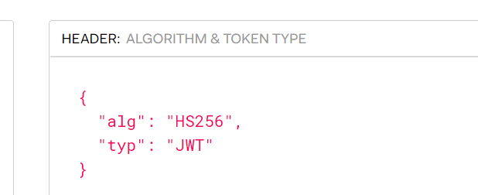
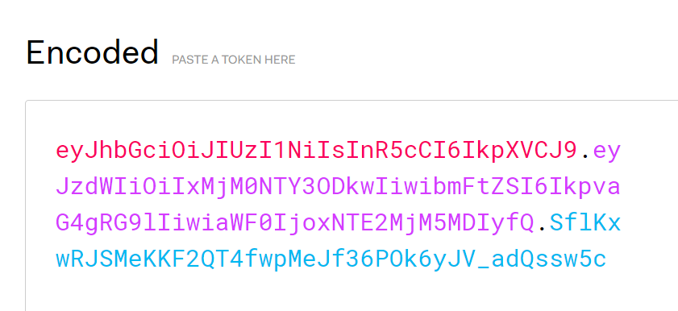
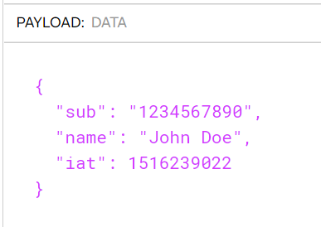
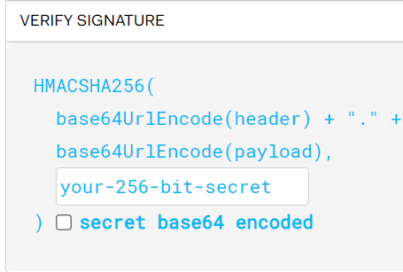

Slide 16
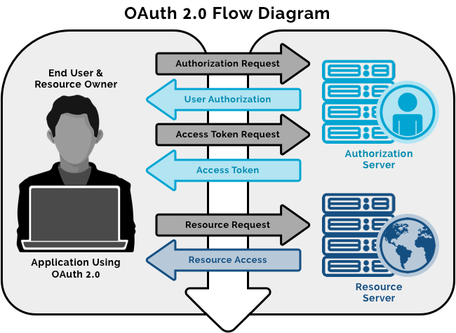
The OAuth (open authorization) protocol was developed by the Internet Engineering Task Force and enables secure delegated access. It lets an application access a resource that is controlled by someone else (end user). This kind of access requires Tokens, which represent delegated right of access.

Slide 17
SSO – Single Sign On
<dependency>
<groupId>org.springframework.cloud</groupId>
<artifactId>spring-cloud-starter-oauth2</artifactId>
</dependency>
security:
oauth2:
client:
clientId: fb1ff2ecaa7e72b4f75c
clientSecret: c3d1cefad1616fdad55f60cf7811e0d4785eee3d
accessTokenUri: https://github.com/login/oauth/access_token
userAuthorizationUri: https://github.com/login/oauth/authorize
clientAuthenticationScheme: form
resource:
userInfoUri: https://api.github.com/user
preferTokenInfo: false

Slide 18
@RestController
public class MyController {
@GetMapping("/")
public String sayHelloOauth2(Principal principal)
{
return principal.getName()+" Welcome Oauth2 Cloud";
}
@EnableOAuth2Sso in the application

